Slide 1

LLM-FIne Tuned Financial Advisor
Northeastern University
DS5500: Data Science Capstone
P1 Presentation
Laasya Anantha Prasad
Krishna Venkatesh
Rakshak Kunchum

Slide 2
What is our Project?
Addresses Gaps in Personal Finance: Traditional tools struggle to meet the complex and rapidly changing needs of modern financial planning.
Limitations of Traditional Advice: Often results in delayed, inaccurate, or generalized recommendations, affecting optimal decision-making.
AI-Driven Solution: Leverages advancements in Artificial Intelligence (AI) with Large Language Models (LLMs).
Goal: Develop a financial advisory tool that provides real-time, personalized insights.
Focus Areas: Supports individual needs in budgeting, investment analysis, and risk assessment.

Slide 3



Limitations of Traditional Methods for personal finance
Inconvenience
Limited Accessibility
Static Knowledge
Requires scheduling and travel, making it time-consuming
Restricted to business hours, unsuitable for urgent needs
Relies on advisor expertise, often lacking real-time updates.

Slide 4



WHY Choose Large language Models for personal Finance tools?
Access Anywhere
Real-Time Data
Efficiency,Consistency, and simply better
Provides financial guidance anytime, from any location.
Delivers the latest insights based on current market data.
Ensures quick, reliable, and enhanced financial support.

Slide 5



DatA Sources
Financial Alpaca Dataset
Source: Hugging Face
Data Acquisition : Combination of Stanford Alpaca and FIQA data and data generated from GPT3.5.
Number of records : Around 68k entries
2. FinTalk-19k Dataset
Source: Hugging Face
Data Acquisition : Extracted from public reddit combinations and tagged with 3 data categories -"Personal Finance", "Financial Information", and "Public Sentiment".
Number of records : > 19,000 entries

Slide 6
Dataset Description
Dataset columns | Data type | Description | Data Example
Instruction | String | The question or topic of the conversation. | What can I do to raise my credit score after Discover closed my account due to a fraudulent charge and my score dropped 70 points?
Context | String | Background or additional details about the conversation. | You've had a Discover card for six years without issues. Recently, you noticed three $100 charges from gas stations in a state you’ve never visited. Discover helped you dispute the charges but closed your account, leading to a 70-point drop in your credit score.
Response | String | The answer or information provided in response. | If you believe the fraudulent charge was not your fault, you may be able to dispute the account closure with Discover and have the negative impact on your credit score reversed. You can call Discover's customer service and explain the situation, asking them to reopen the account and issue a new card. Additionally, you can try to rebuild your credit score by applying for a few cards now to avoid taking another average age hit in the future.
Tag | String | Category label for the conversation. | Personal Finance
Text | String/Null | Empty column mostly, hence dropping. | NA

Slide 7
Data Cleaning
Objective:
Combine insights from two distinct financial datasets—Financial Alpaca and FinTalk-19k—to develop a unified dataset for finance-focused question-answer pairs.
Steps:
Data Cleaning:
Remove Extra Whitespace and Line Breaks
Remove Dashes
Remove Bullets
Remove Non-ASCII Characters

Slide 8
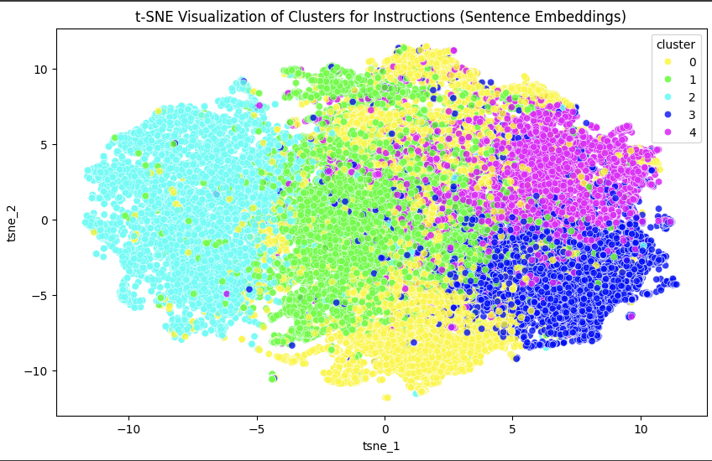
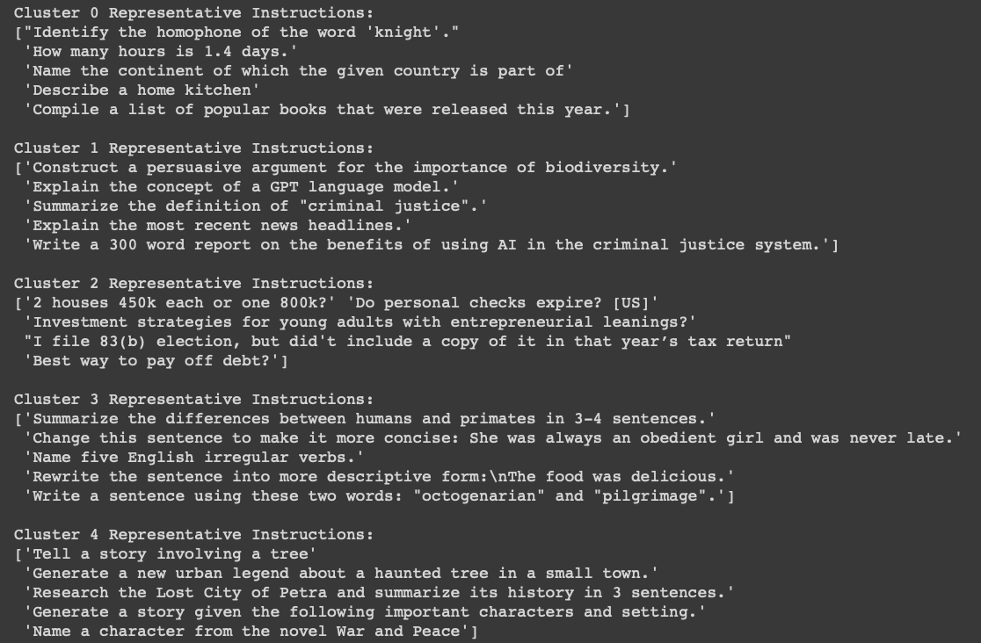
Extracting finance Q&A pairs based on embeddings from the finance alpaca dataset
Converted instructions to embeddings (vector data) using sentenceTransformer (model: all-MiniLM-L6-v2)
Applying Kmeans clustering to group similar instructions. (clusters K=5)
Using t-SNE to reduce the dimensionality of the data and plot the clusters. (Dimensionality reduced to 2D)

Slide 9
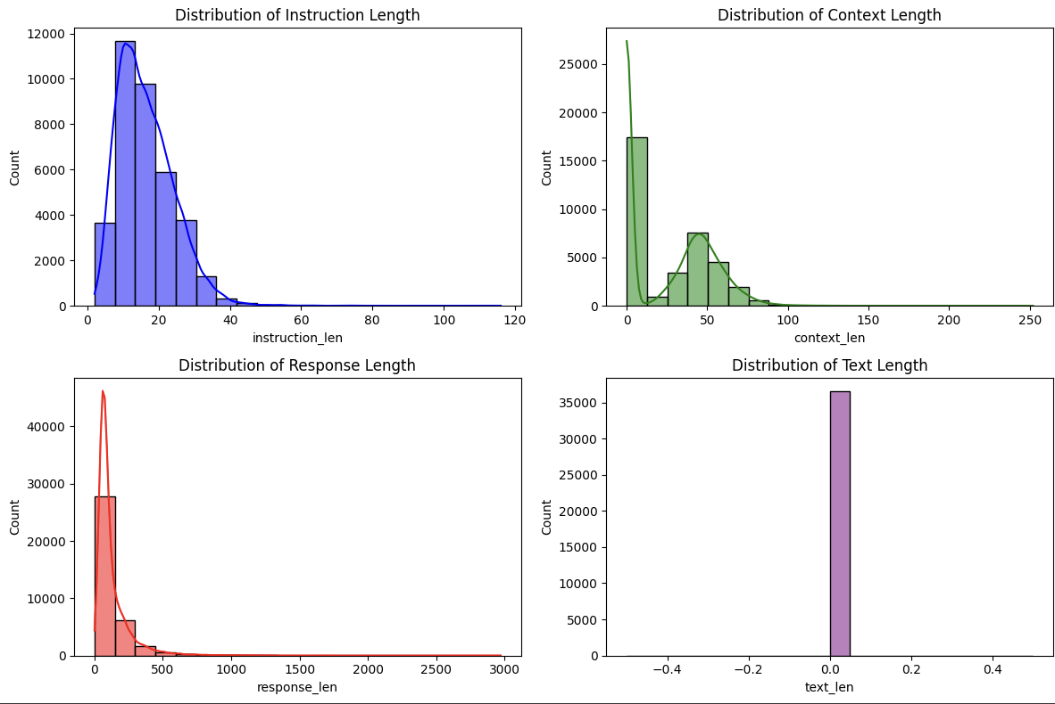
Exploratory Data Analysis
The token distribution analysis helps determine an optimal context window size for fine-tuning. Observing that 95% of the response data falls within a 200-300 token range, 256 tokens is taken as the context window size to efficiently capture the majority of responses.

Slide 10
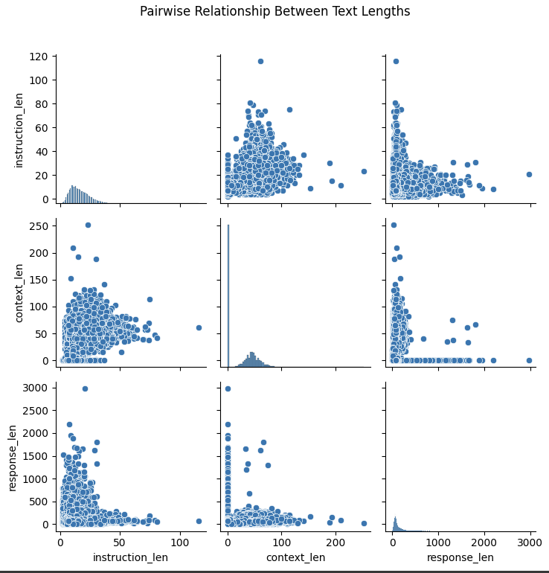
Insights using Pairwise relationships
Insights:
Analyzing Pairwise Relationships: Scatterplots show correlations between instruction, context, and response lengths, helping identify trends and dependencies within the dataset.
Length Distribution Insights: Instruction length tends to be short, with minimal correlation to response length, while context length shows a positive trend with response length.
Model Optimization: Understanding these relationships assists in optimizing model input-output configurations, ensuring efficient handling of varying text lengths

Slide 11
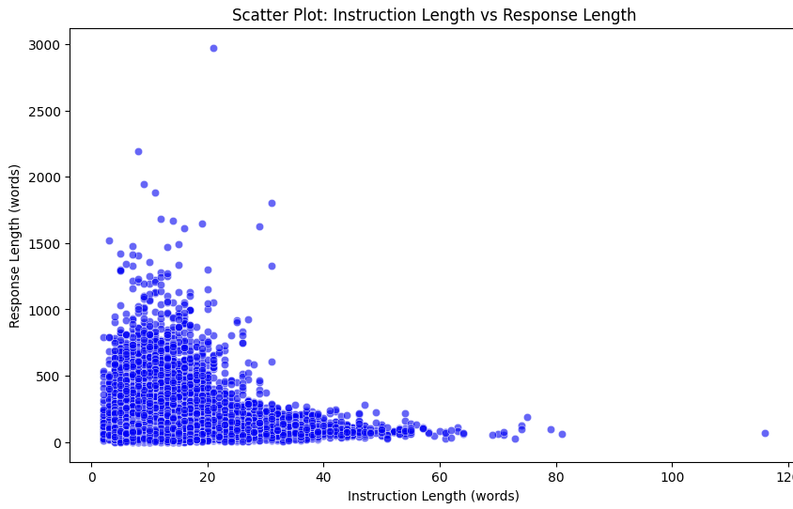
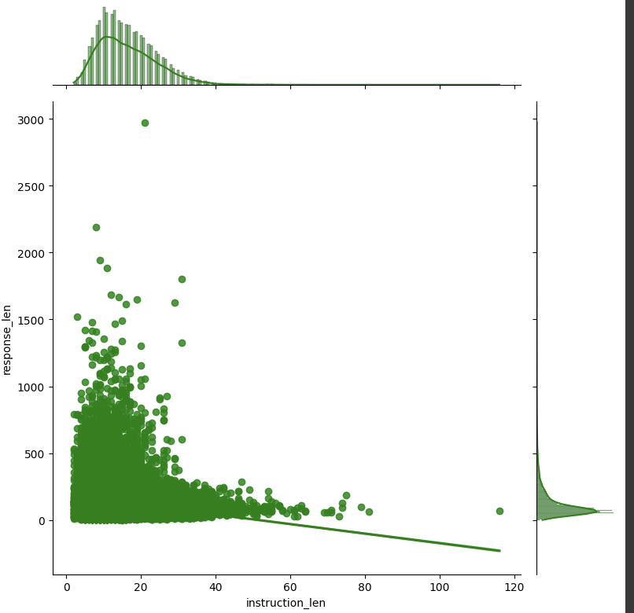
Hypothesis :
Longer instruction (question) lengths lead to longer response (answer) lengths
Pearson Correlation Coefficient: The Pearson correlation coefficient (f) is calculated to quantify the strength and direction.
-0.17
Pearson Score for Hypothesis
The Pearson correlation coefficient of −0.17 shows a weak negative correlation, indicating no meaningful relationship between instruction length and response length. This weak and negative correlation suggests that the hypothesis — "longer instruction lengths lead to longer response lengths" — does not hold in this analysis

Slide 12



Approaches: Leveraging LLMs
Large Language Models
We deploy large language models (LLMs) fine-tuned on financial datasets, enhancing their ability to interpret complex financial texts and respond to sector-specific queries accurately.
Potential LLMs to be explored:
Mistral 7B
Llama 7B
PEFT/QLoRA
QLoRA modifies a minimal set of model parameters, allowing for rapid adaptation to financial contexts. This method improves model responsiveness and accuracy without the extensive computational demands of full retraining.
Vector Database
Vector databases (VectorDBs) store high-dimensional vectors, enabling efficient similarity search for embeddings from large language models (LLMs). This allows LLMs to quickly retrieve relevant context, supporting tasks like semantic search and question-answering

Slide 13
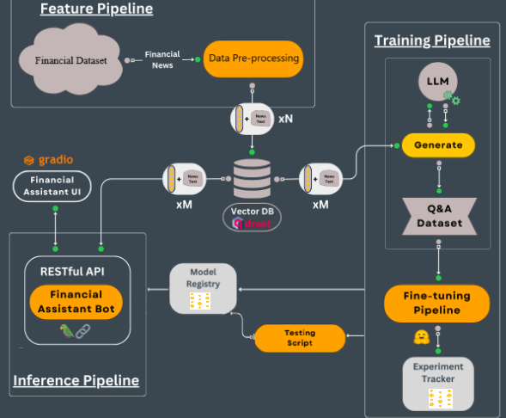
What the model architecture looks like
Feature Pipeline:
Financial Q&A datasets are processed through a streaming pipeline and stored in a Vector DB (Qdrant).
Training Pipeline:
A pre-trained LLM generates a Q&A dataset from the news data for fine-tuning.
Model Fine-tuning and MLOps:
LoRA weights adjust the model parameters, with tracking done by Weights & Biases.
Inference Pipeline:
The fine-tuned model is deployed via Gradio for user to interact and get advice.
(Iusztin P. The framework to deploy LLM systems to do RAG | Decoding ML. Medium.)

Slide 14
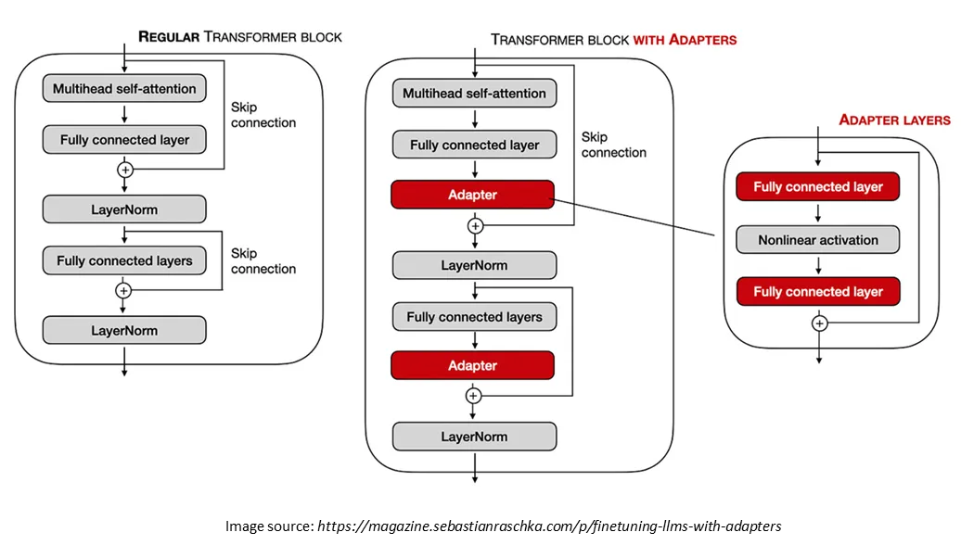
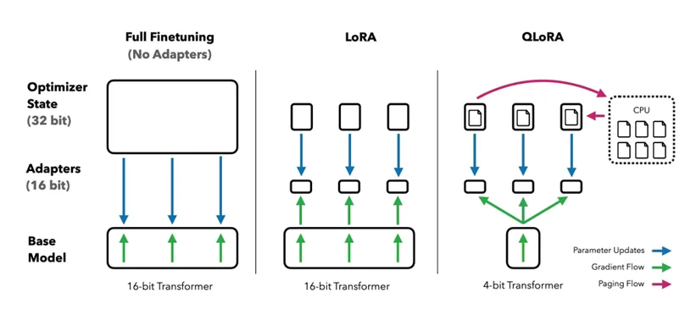
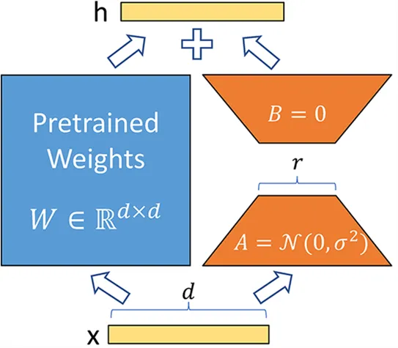
Parameter Efficient Fine Tuning
We are using PEFT with QLoRA configuration with 8-bit precision to adaptively fine-tune a causal language model by applying low-rank matrix adaptations on the 'q_proj' and 'v_proj' modules, optimizing memory and computational efficiency for training on limited VRAM.
(QLORA: Efficient Finetuning of Quantized LLMs)

Slide 15
Large Language MOdels for fine tuning
LlaMA 7B
Model Name: LLaMA (Large Language Model Meta AI)
Organization: Developed by the FAIR team, Meta AI
Model Architecture: Transformer-based, auto-regressive language model
Parameters: 7 billion (7B) parameters
Efficiency: Achieves strong performance across NLP tasks while being computationally efficient for fine-tuning
Specialization: Tailored for high-resource languages, with versatile applications across summarization, translation, question-answering, etc.
Model Paper: "LLaMA: Open and Efficient Foundation Language Models"
Mistal 7B
Model Name: Mistral 7B
Organization: Developed by Mistral AI
Model Architecture: Transformer-based, auto-regressive language model with sparse attention mechanisms for efficiency
Parameters: 7 billion (7B) parameters
Efficiency: Uses advanced compression and attention techniques, allowing high performance with reduced memory and compute requirements
Specialization: Effective across tasks like summarization, dialogue, translation, and text generation, with emphasis on minimal latency for real-time applications
Model Paper: Paper link pending publication by Mistral AI
** Other potential LLMs to be considered: Falcon 7B, LlaMA 3B, Distill-GPT

Slide 16
Results and Challenges
Current Performance Metrics
Training Loss: Currently available to evaluate model training and adaptation performance.
Perplexity: Currently available to assess model accuracy in predicting sequences.
Metrics to Integrate :
ROUGE Score: To compare overlap between generated and reference text.
Current Challenges :
VRAM Limitations: Insufficient VRAM restricts the model's capacity and batch size, impacting performance and training efficiency.
GPU Constraints: Limited GPU availability slows down training and increases processing time, affecting experiment scalability and iteration speed.
4-6*
SOTA Perplexity LlaMA Model Scores
7.12
Current Fine tuned LlaMa Perplexity model scores
Step | Training Loss
50 | 2.264300
100 | 1.973800
150 | 1.853890
200 | 1.674590
250 | 1.527531
LlaMA 7B fine-tuning
(* Revolutionizing Financial Insights with Llama-3-70B)

Slide 17
NExt Steps for Phase P2
Feature Pipeline:
Completed
Training Pipeline & Model Fine-tuning:
LlaMA Fine Tuning - Completed
Mistral Fine Tuning - In progress
* Other LLMs (if time permits)
Vector data Pipeline:
* In Progress
Inference Pipeline:
API Development - Pending
Financial Advisor UI - Pending

Slide 18



CONCLUSIONS
Enhanced Decision-Making and Efficiency:
The Financial LLM Advisor automates complex tasks, boosting accuracy and speeding up financial decisions, reducing errors and saving time.
Personalized Financial Guidance for Individuals:
This tool provides personalized financial advice, helping individuals make smarter investment and savings choices, boosting financial empowerment for all.
Scalable and Accessible Financial Services:
Using advanced LLM technology, we make expert financial advice more affordable and accessible, democratizing financial expertise for broader use.

Slide 19
Questions?
ThanK YoU

